Slide 1
A poem is a house made of words.
(a simple theory of poetry)
1. Where does a certain
stanza
verse
line
word take us?
2. How does it do so?
rhythm
rhyme
imagery

Slide 2
Andrew Motion, In the Attic (1972)
Even though we know now
your clothes will never
be needed, we keep them,
upstairs in a locked trunk.
Sometimes I kneel there,
holding them, trying to relive
time you wore them, to remember
the actual shape of arm and wrist.
My hands push down between
hollow, invisible sleeves,
hesitate, then lift:
patterns of memory:
a green holiday, a red christening,
all your unfinished lives
fading through dark summers,
entering my head as dust.

Slide 3
Andrew Motion, In the Attic (1972)
Even though we know now
your clothes will never
be needed, we keep them,
upstairs in a locked trunk.
Sometimes I kneel there,
holding them, trying to relive
time you wore them, to remember
the actual shape of arm and wrist.
My hands push down between
hollow, invisible sleeves,
hesitate, then lift:
patterns of memory:
a green holiday, a red christening,
all your unfinished lives
fading through dark summers,
entering my head as dust.

Slide 4
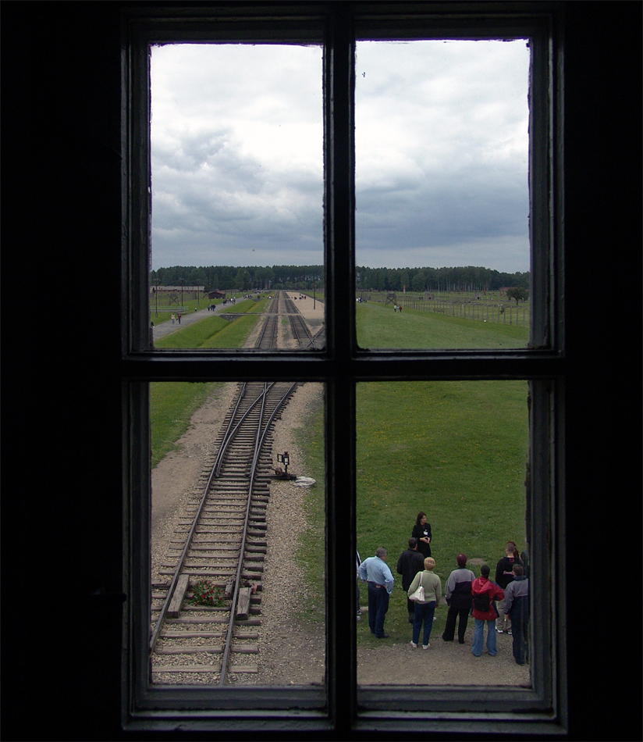
Blick auf die Juden- oder Triage-Rampe
im KZ Auschwitz-Birkenau
where the following lines came to my mind:
one enduring wish for chances like /
my own: to leave as simply as I do
Andrew Motion, Anne Frank Huis,1975
Mark Keller www.film-bild-bildung.ch
Notes:
Das Schicksal des jüdischen Volkes ist vielleicht das erschütterndste Drama der Weltgeschichte.
Ignaz von Döllinger, 1881

Slide 5

Anne Frank Huis
(I generally leave the title away at first)
Even now, after twice her lifetime of grief
and anger in the very place, whoever comes
to climb these narrow stairs, discovers how
the bookcase slides aside, then walks through
shadow into sunlit rooms, can never help
but break her secrecy again. Just listening
is a kind of guilt. The Westerkerk repeats
itself outside, as if all time worked round
towards her fear, and made each stroke die
down on guarded streets. Imagine it -
three years of whispering and loneliness
and plotting, day by day, the Allied line
in Europe with a yellow chalk. What hope
she had for ordinary love and interest
survives her here, displayed above the bed
Andrew Motion reading
as pictures of her family; some actors;
fashions chosen by Princess Elizabeth.
And those who stoop to see them find
not only patience missing its reward,
but one enduring wish for chances like
my own: to leave as simply as I do,
and walk (where couples drift) at ease
up dusty tree-lined avenues, or watch
a silent barge come clear of bridges
settling their reflections in the blue canal.
Andrew Motion (1975)

Slide 6
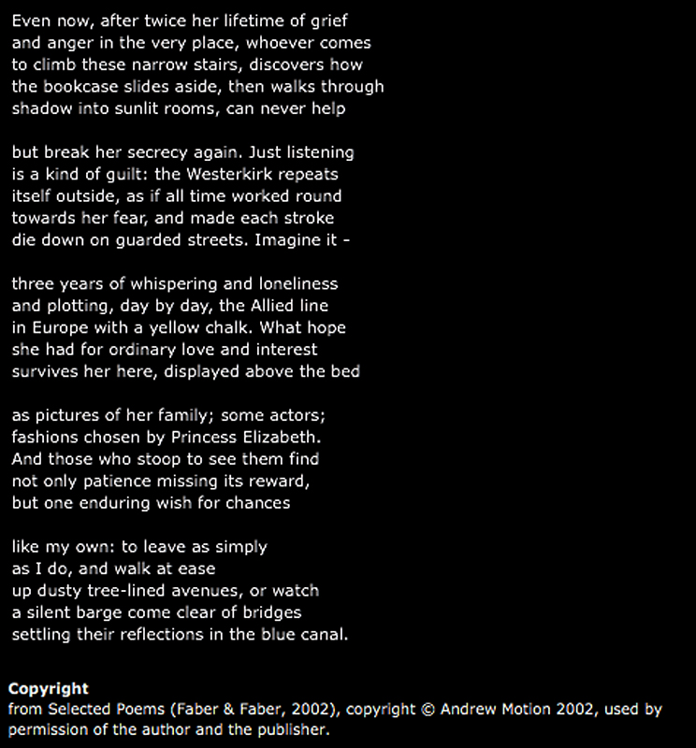

Slide 7
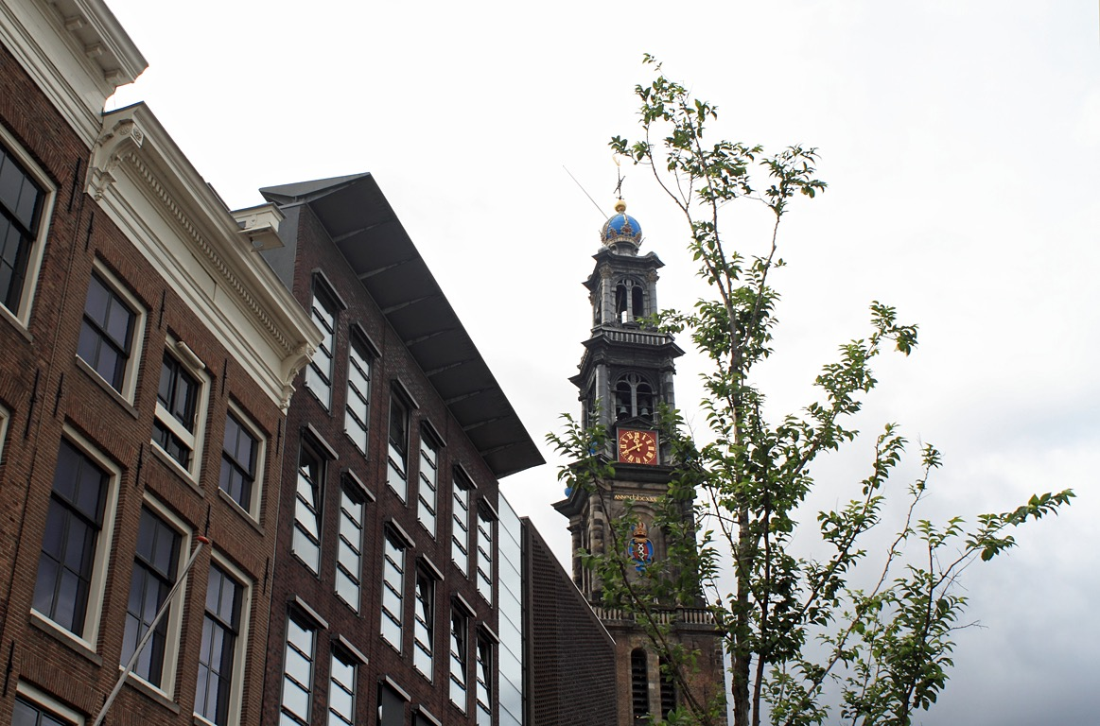
The Westerkerk repeats
itself outside

Slide 8
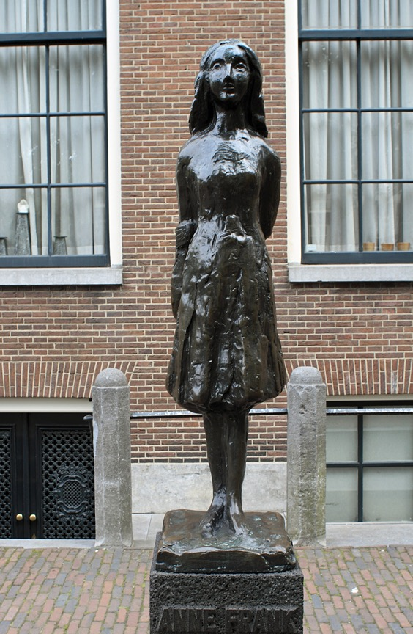
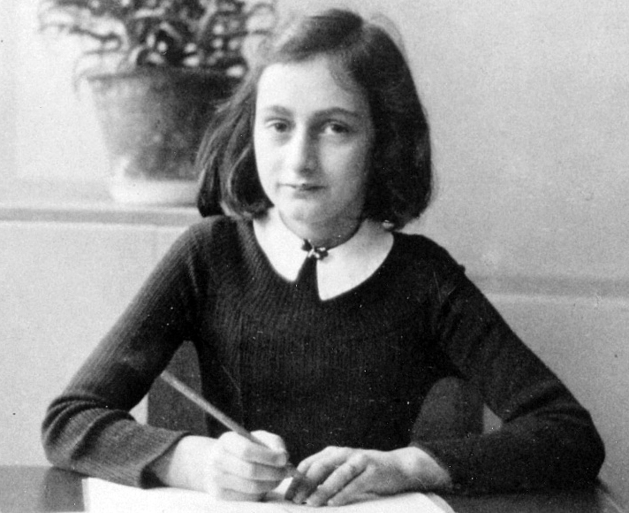
© Universal History Archive / Univer
Mari Silverster Andriessen (1897-1979)

Slide 9
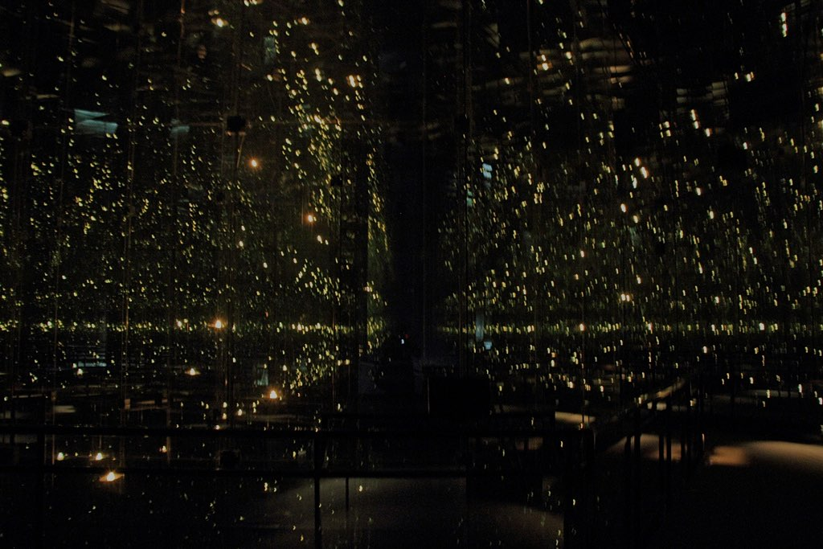
No society or individual can deal with such a catastrophe without some degree of moderating manipulation. This is why Anne Frank’s diary is so popular. We can deal with one girl. A million children – that is a lot harder. This is probably why “Schindler’s List” was shot in black and white, providing some distance, and why it focuses on the story of a man who risked himself to save others, and not on that of a killer.
Yuval Ben-Ami (*1976, Jerusalem, author, journalist, traveler, critic)
http://972mag.com/the-beaten-path-framing-the-story-at-yad-vashem-part-8/98449/ Nov 25, 2014
Children‘s Memorial, Yad Vashem, Jerusalem

